Slide 2
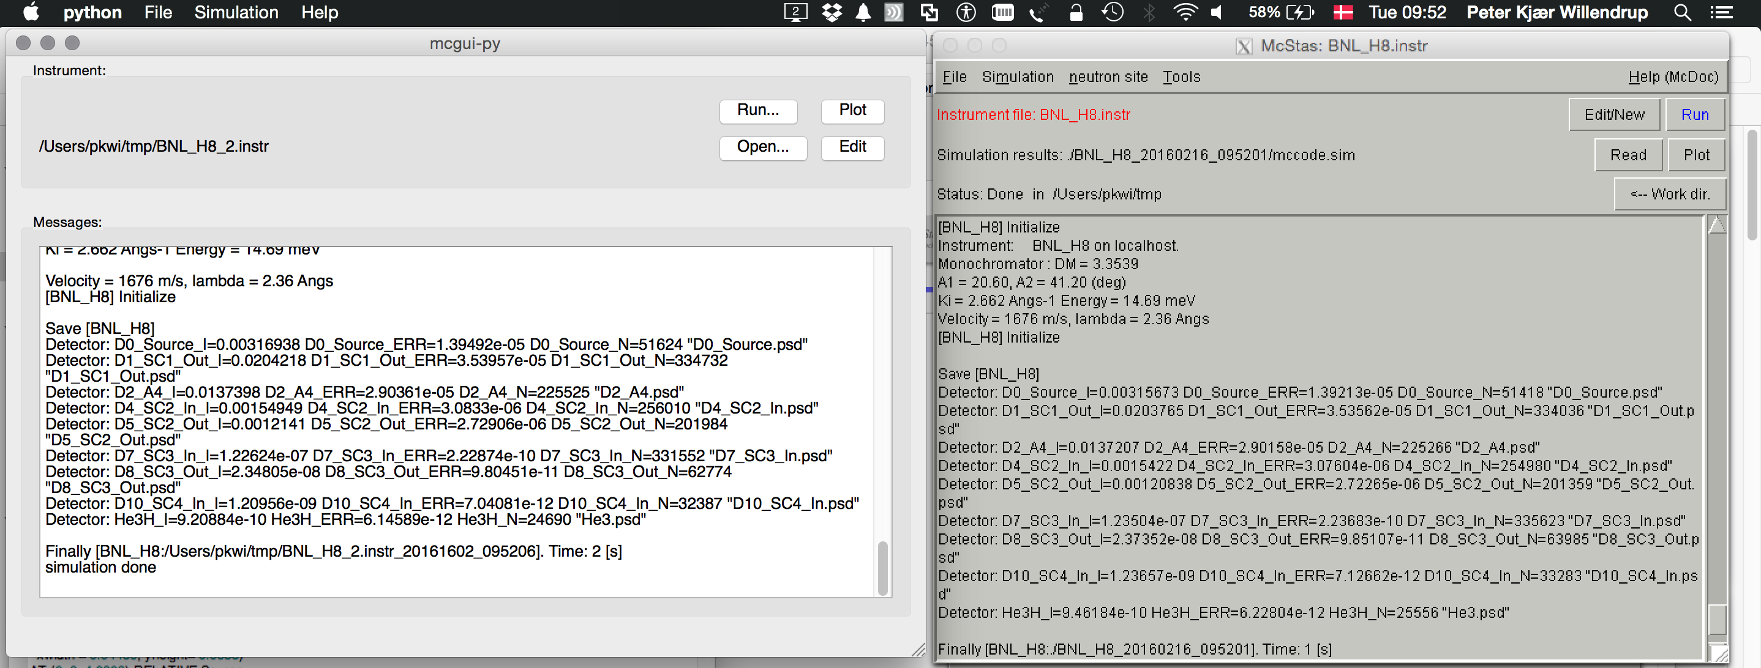






mcgui - pl vs py versions
October 2018
ORNL McStas workshop, October 18th-19th 2018

Slide 3
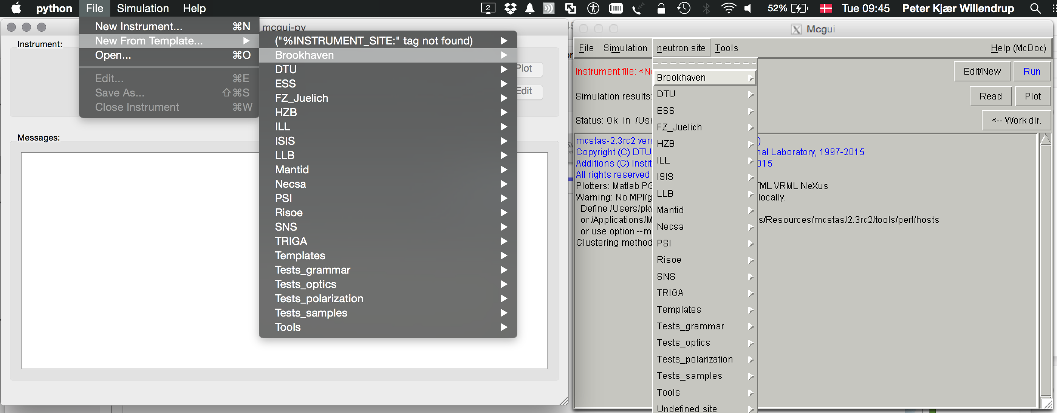
mcgui (python) vs mcgui.pl/mcgui-pl
October 2018
ORNL McStas workshop, October 18th-19th 2018

Slide 4
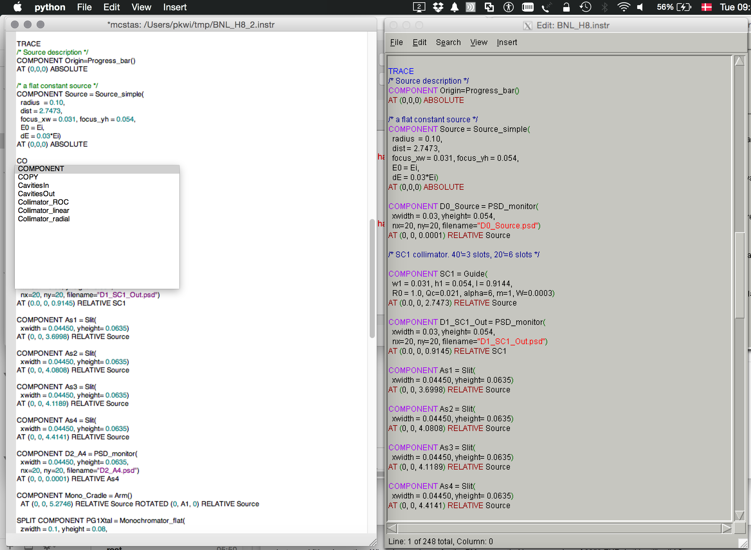
mcgui - pl vs py versions
October 2018
ORNL McStas workshop, October 18th-19th 2018

Slide 5
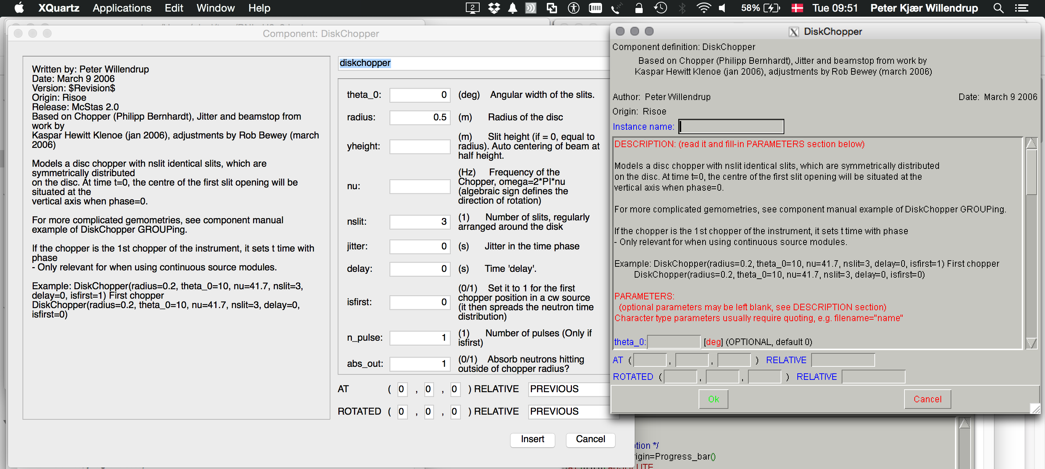
mcgui (python) vs mcgui.pl/mcgui-pl
October 2018
ORNL McStas workshop, October 18th-19th 2018

Slide 6
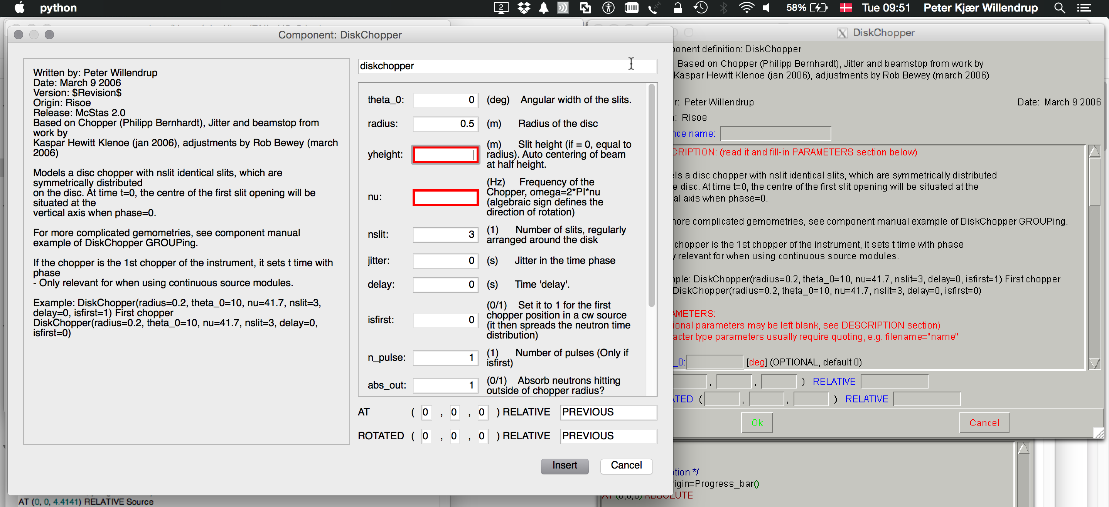
mcgui (python) vs mcgui.pl/mcgui-pl
October 2018
ORNL McStas workshop, October 18th-19th 2018

Slide 7
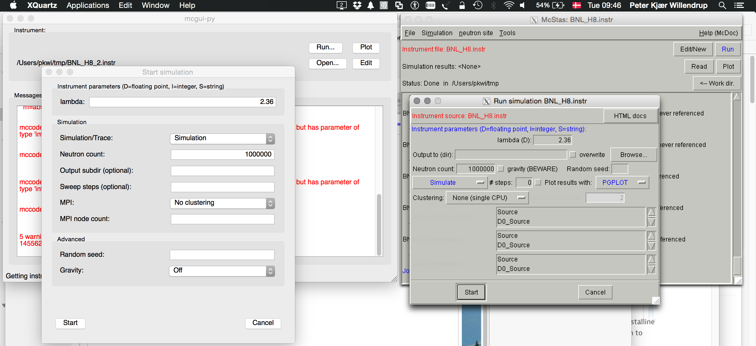
mcgui (python) vs mcgui.pl/mcgui-pl
October 2018
ORNL McStas workshop, October 18th-19th 2018

Slide 8
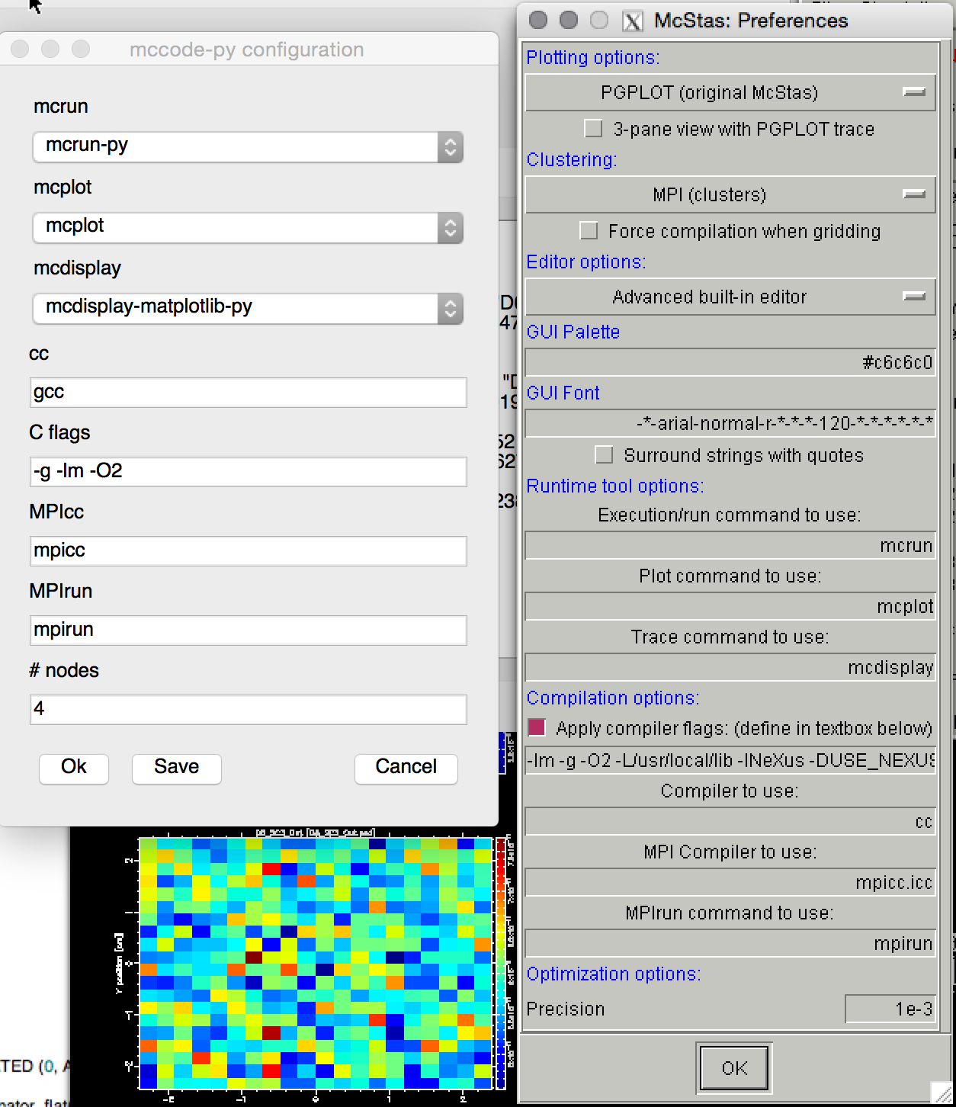
mcgui - pl vs py versions
October 2018
ORNL McStas workshop, October 18th-19th 2018

Slide 9
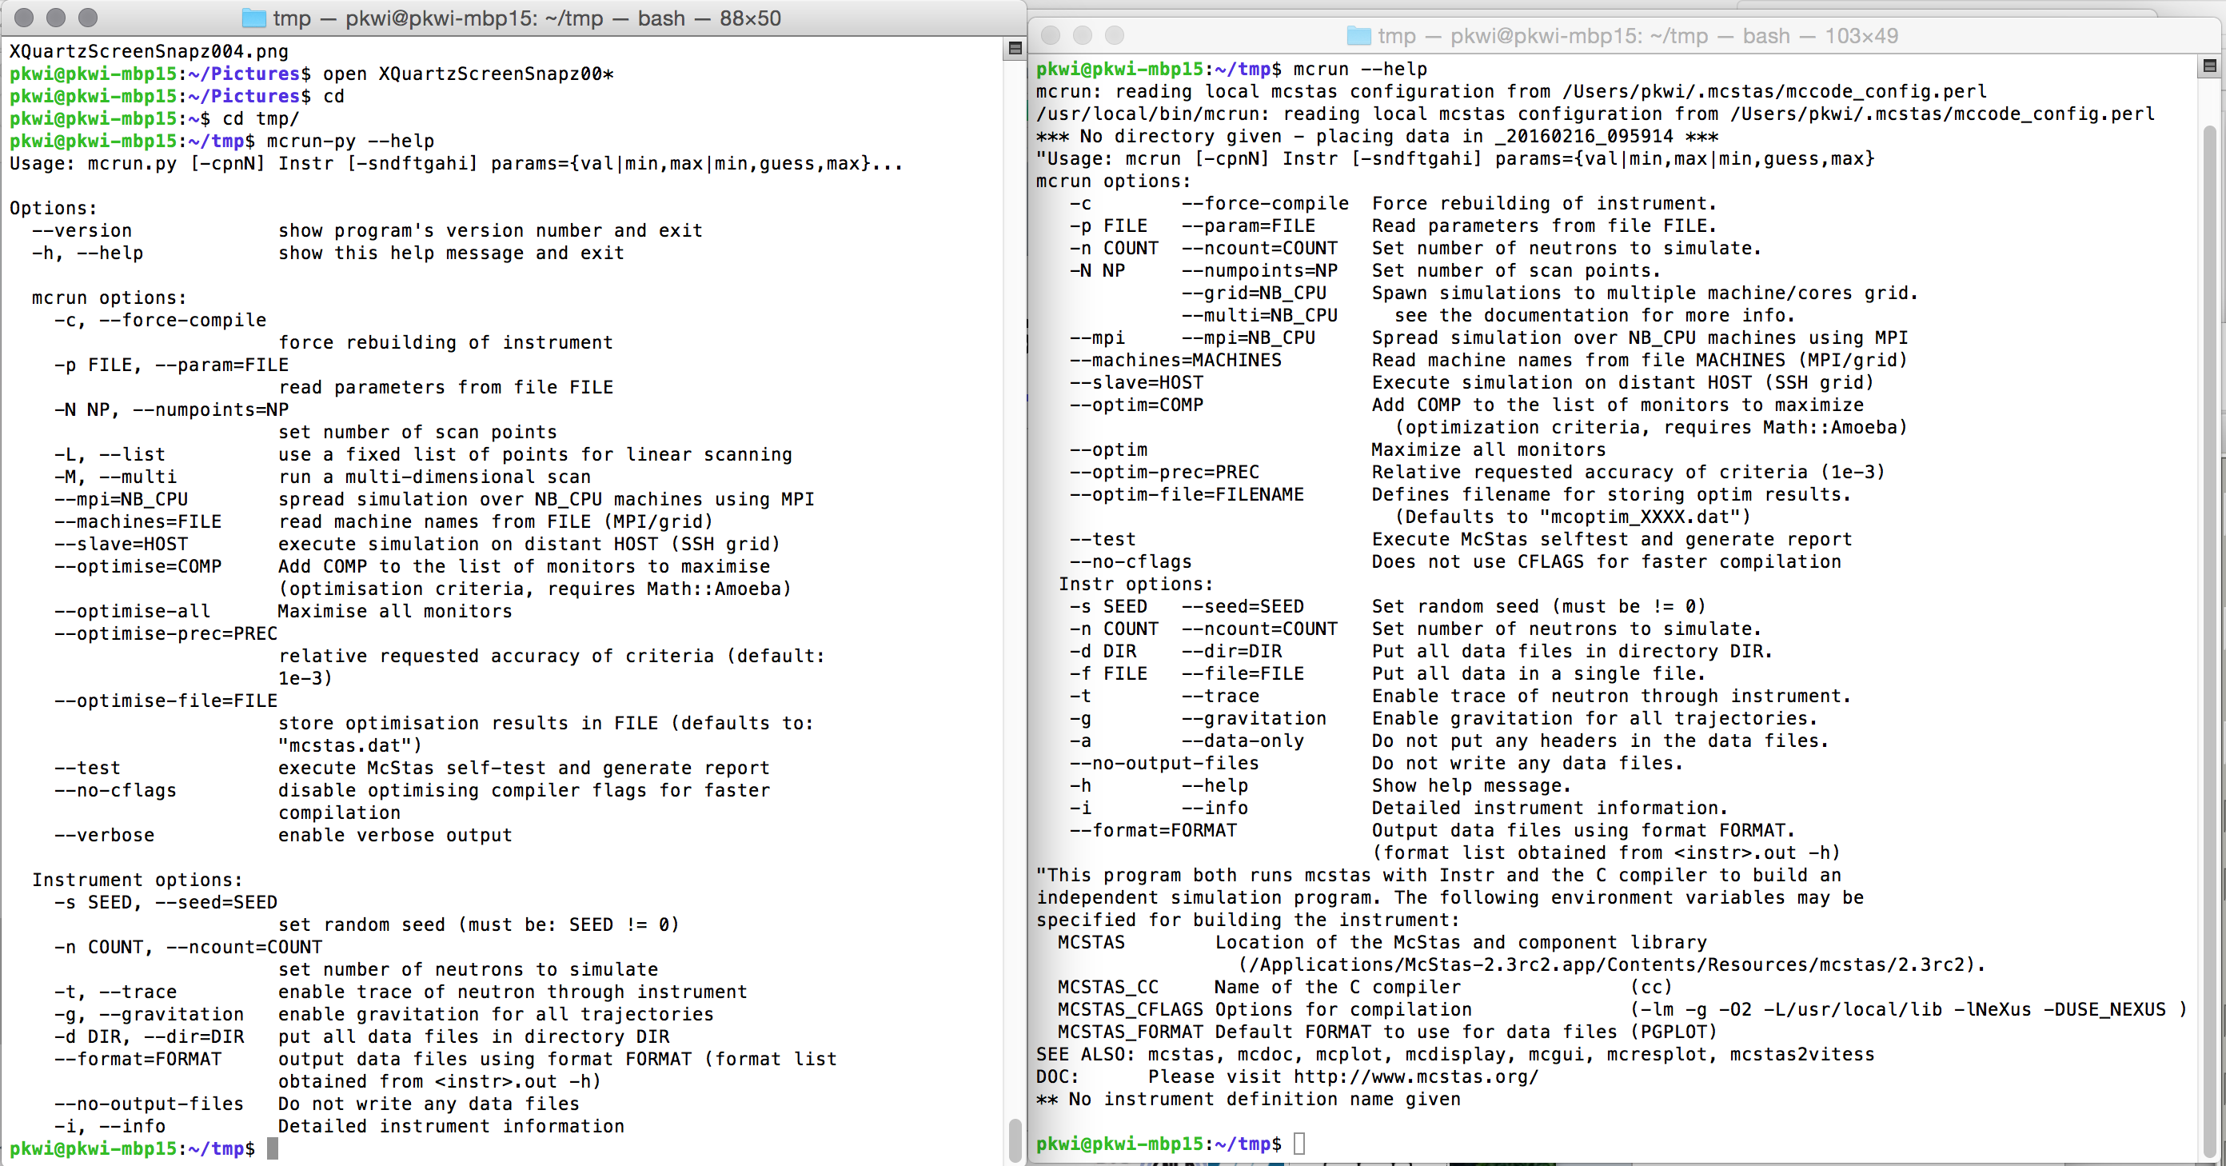
mcrun (py) vs. mcrun.pl/mcrun-pl version
October 2018
ORNL McStas workshop, October 18th-19th 2018

Slide 10
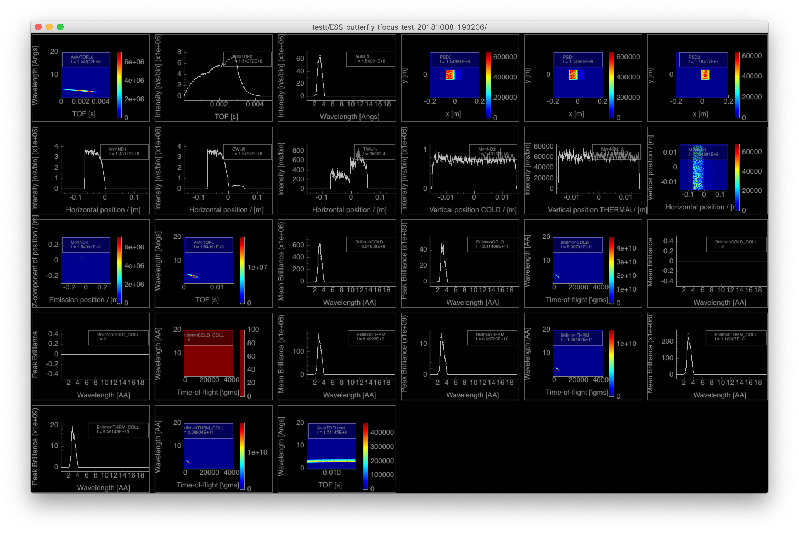
mcplot /mcplot-pyqtgraph (python)
October 2018
ORNL McStas workshop, October 18th-19th 2018

Slide 11
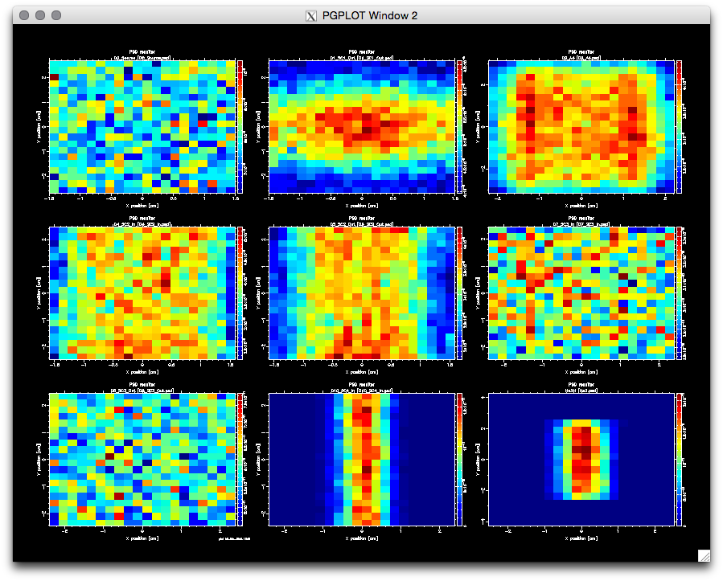
mcplot.pl/mcplot-pl (--format=PGPLOT)
October 2018
ORNL McStas workshop, October 18th-19th 2018

Slide 12
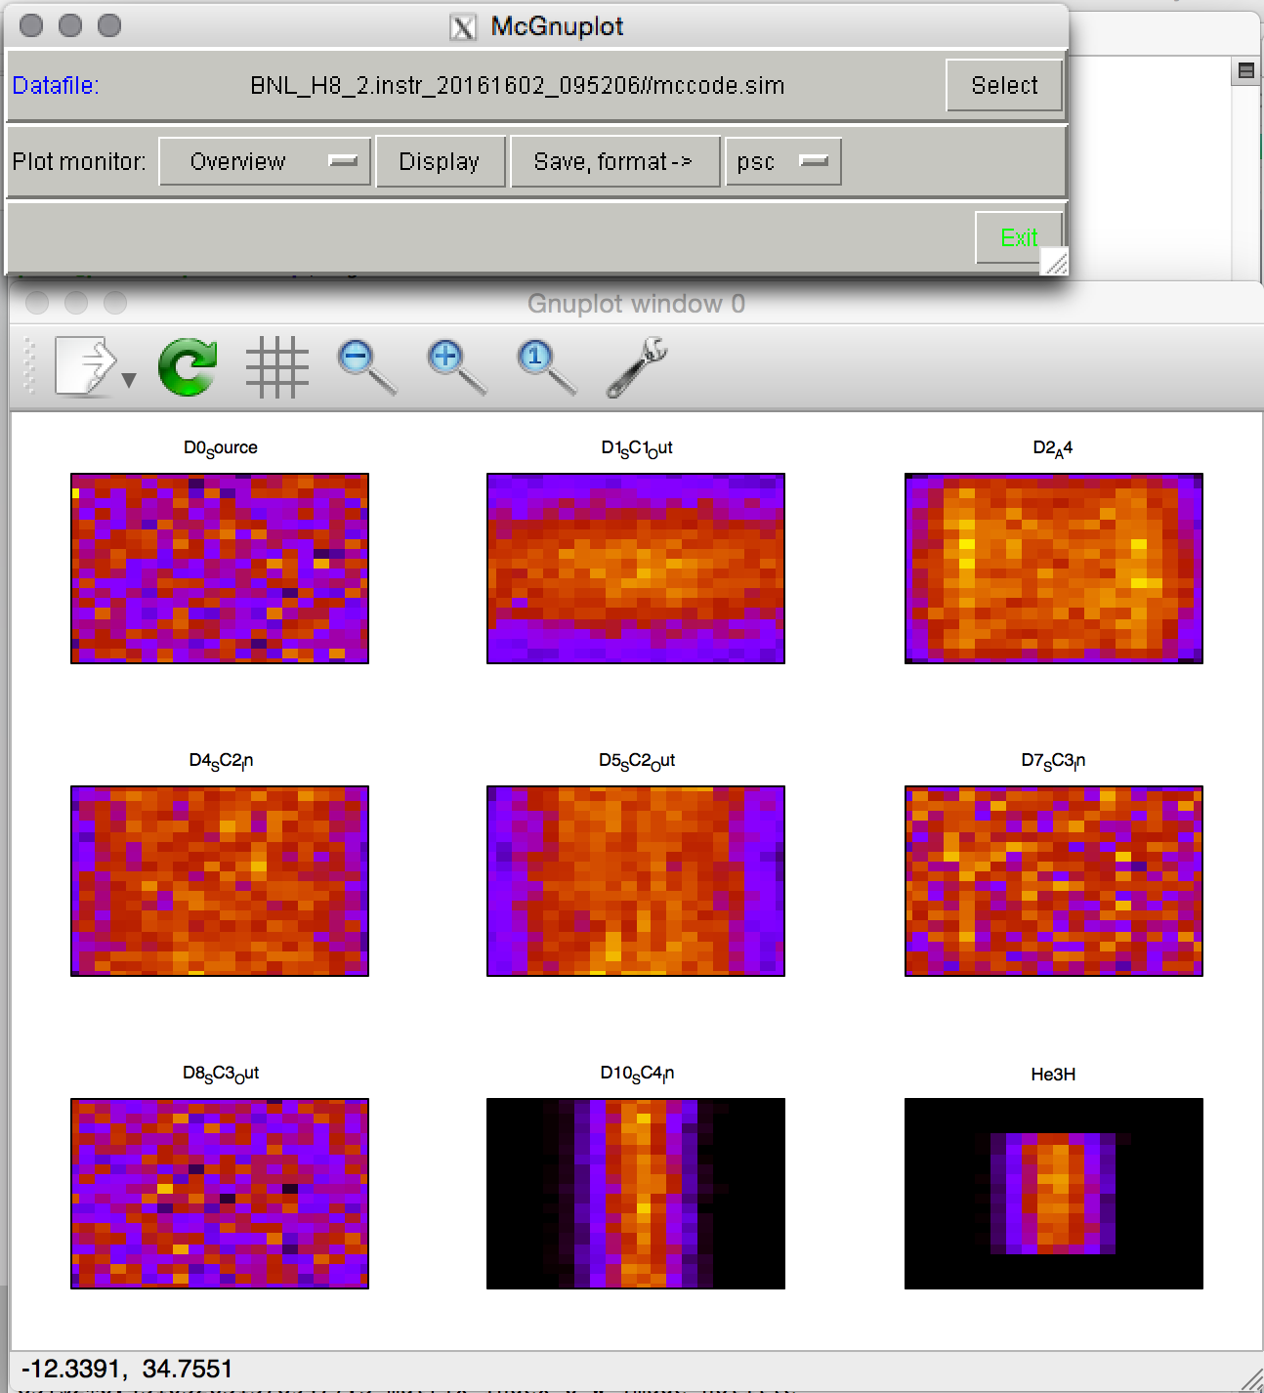
mcplot.pl/mcplot-pl --format=Gnuplot
October 2018
ORNL McStas workshop, October 18th-19th 2018

Slide 13
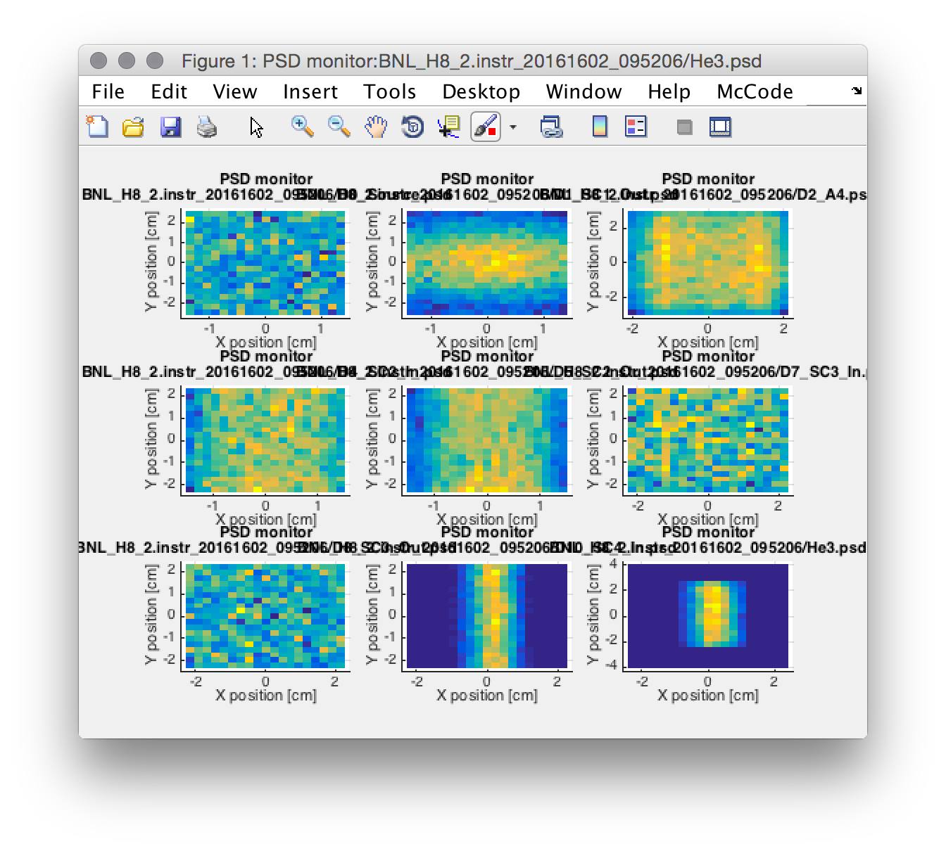
mcplot.pl/mcplot-pl —format=Matlab
October 2018
ORNL McStas workshop, October 18th-19th 2018

Slide 14
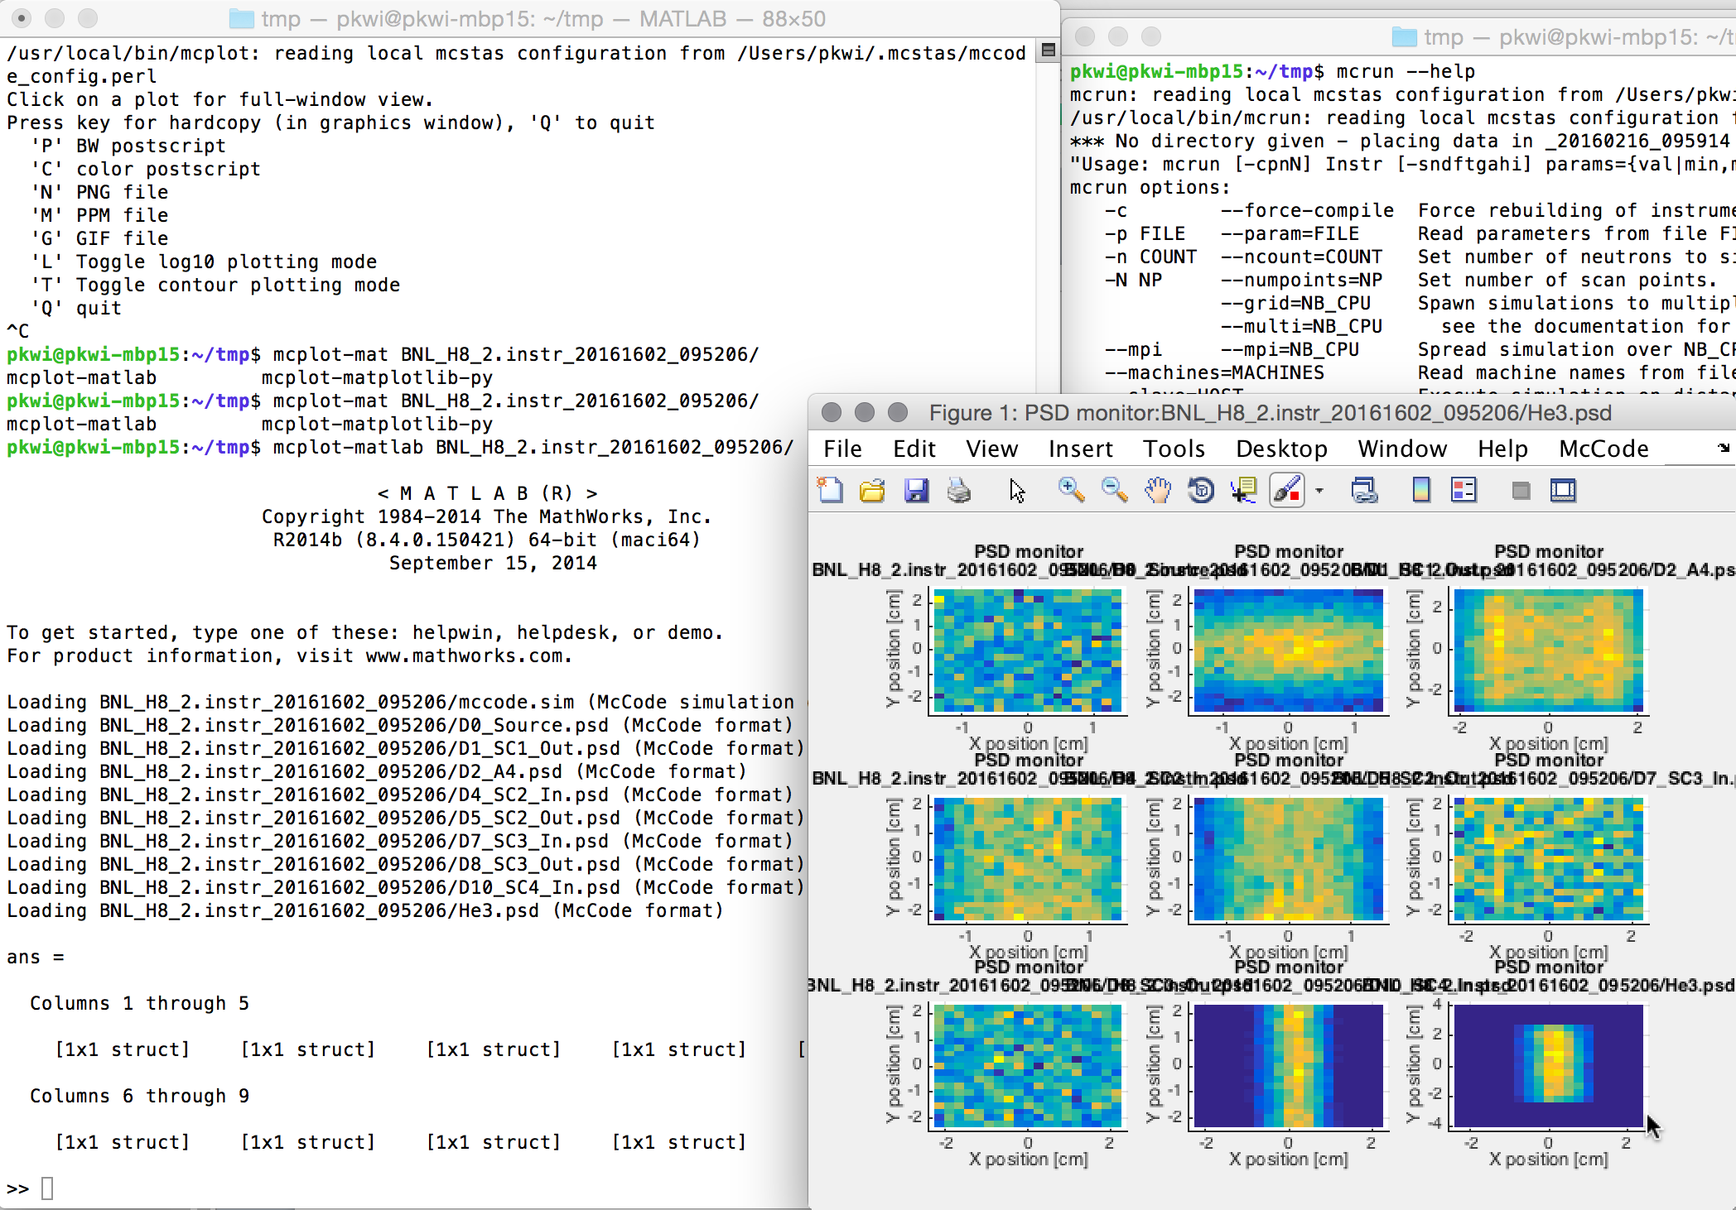
mcplot-matlab (Unix only)
October 2018
ORNL McStas workshop, October 18th-19th 2018

Slide 15
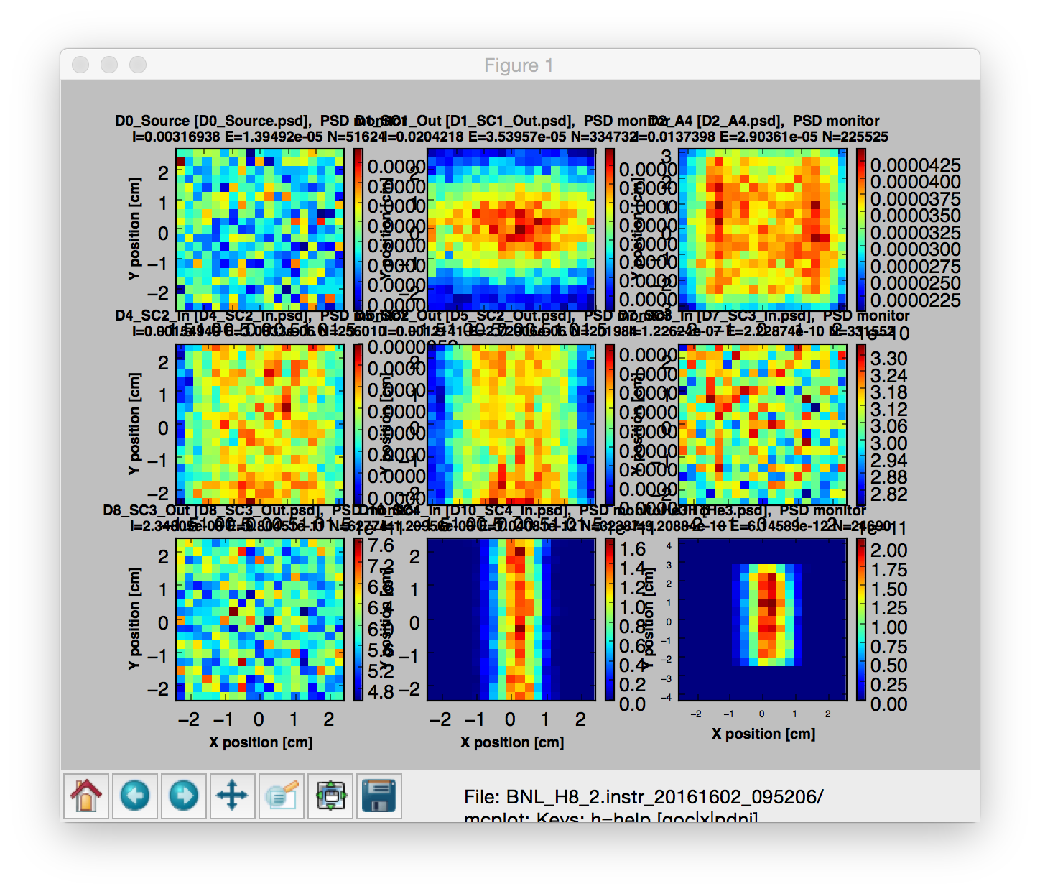
mcplot-matplotlib (python)
October 2018
ORNL McStas workshop, October 18th-19th 2018

Slide 16
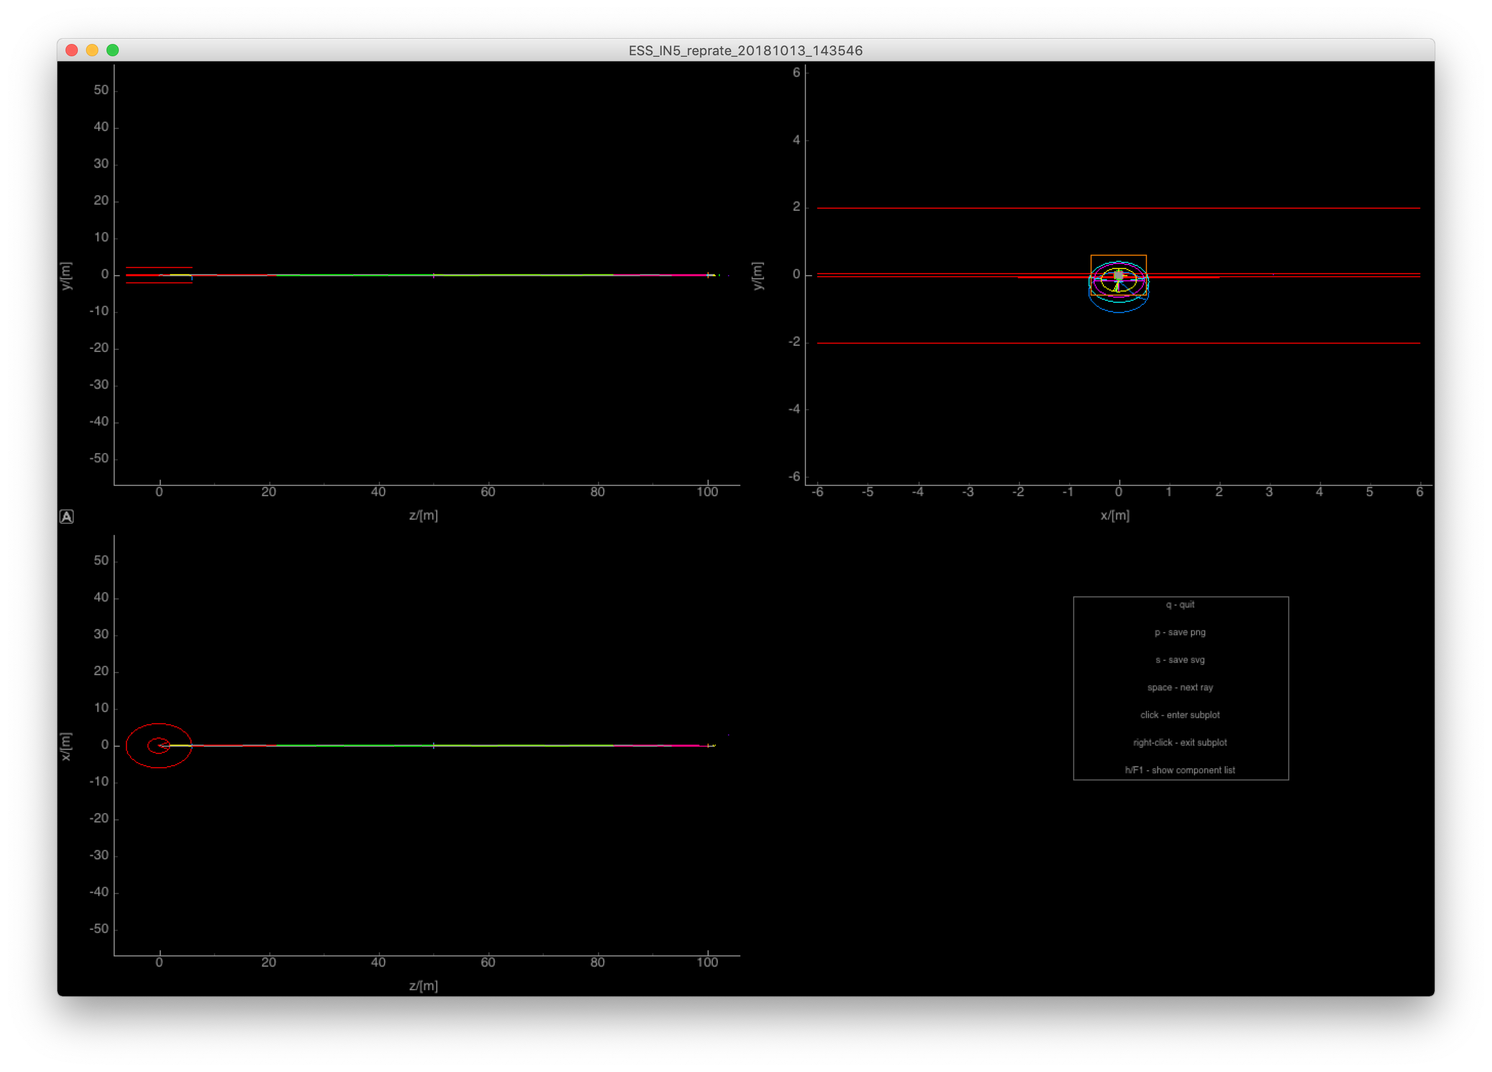
mcdisplay / mcdisplay-pyqtgraph (python)
October 2018
ORNL McStas workshop, October 18th-19th 2018

Slide 17
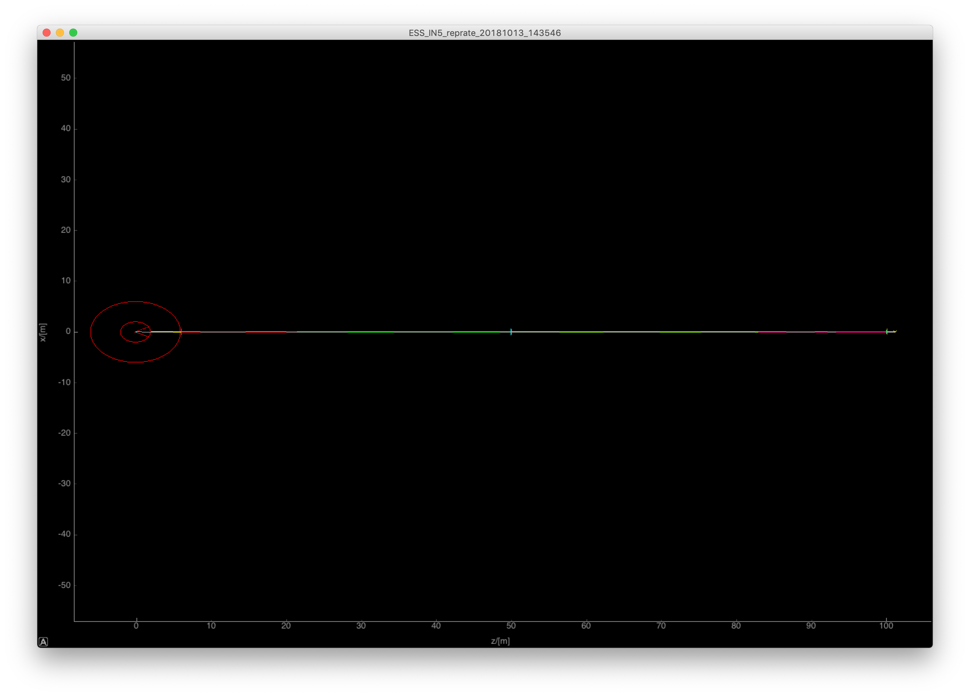
mcdisplay / mcdisplay-pyqtgraph (python)
October 2018
ORNL McStas workshop, October 18th-19th 2018

Slide 18
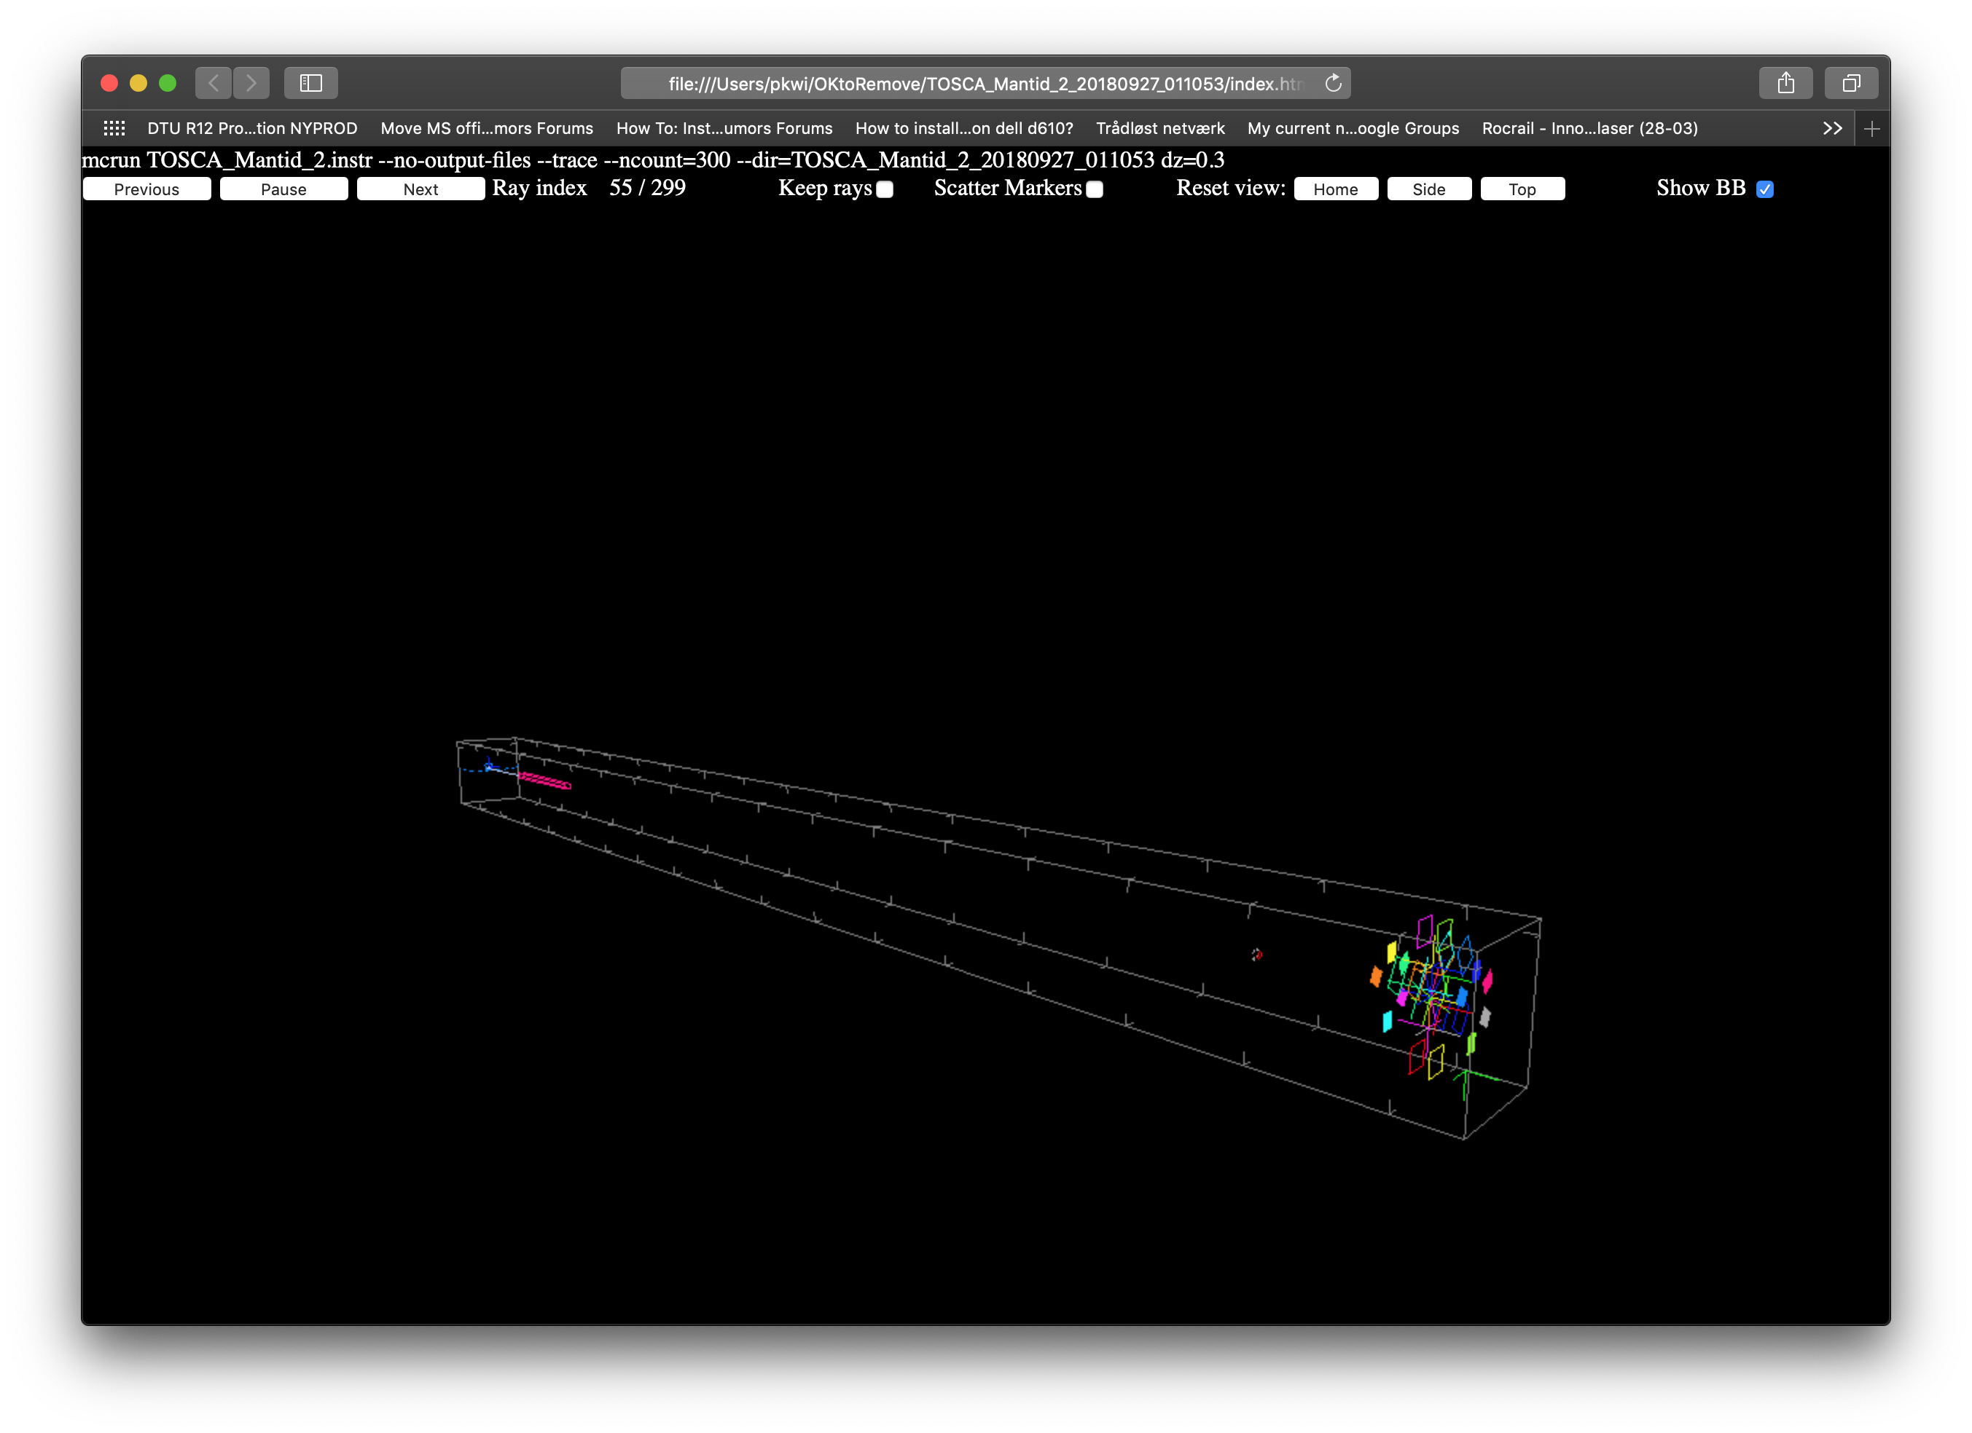
mcdisplay-webgl (python)
October 2018
ORNL McStas workshop, October 18th-19th 2018

Slide 19
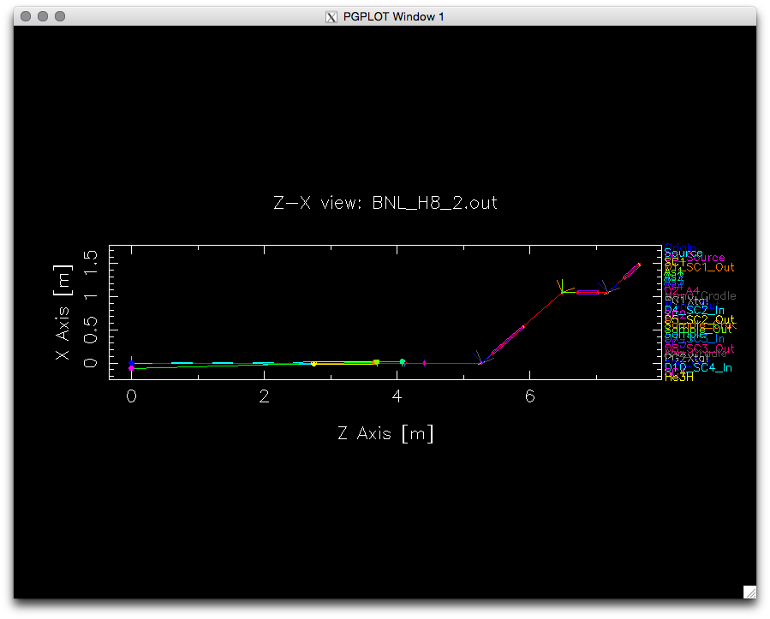
mcdisplay.pl / mcdisplay-pl
October 2018
ORNL McStas workshop, October 18th-19th 2018

Slide 20
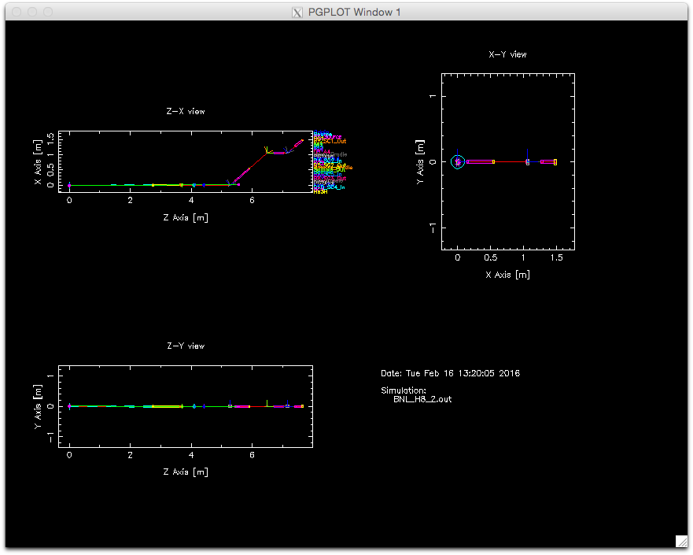
mcdisplay.pl / mcdisplay-pl with -mm
October 2018
ORNL McStas workshop, October 18th-19th 2018

Slide 21
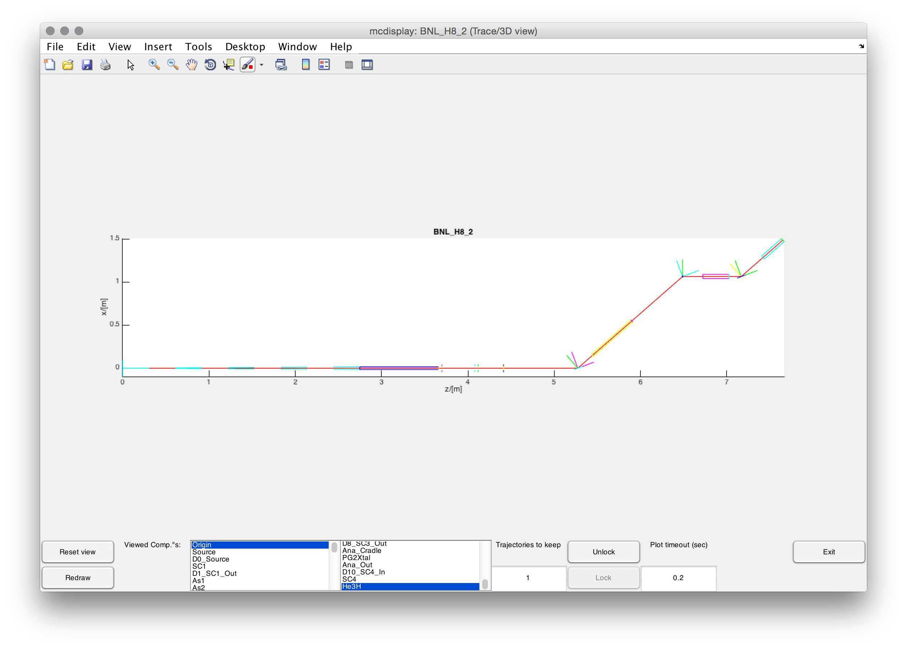
mcdisplay.pl / mcdisplay-pl --format=Matlab
October 2018
ORNL McStas workshop, October 18th-19th 2018

Slide 22
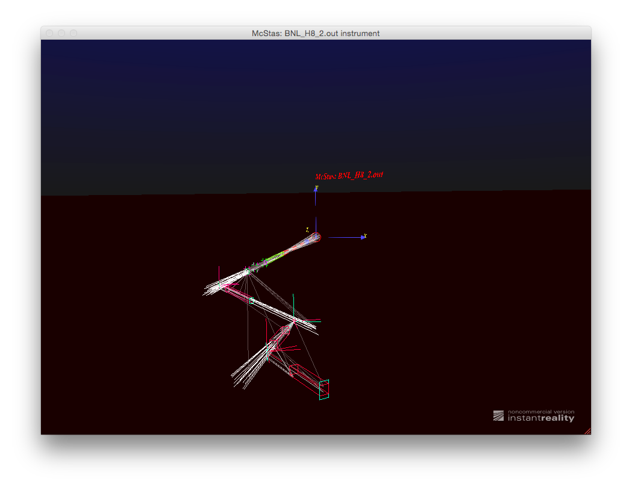
mcdisplay.pl / mcdisplay-pl --format=VRML
October 2018
ORNL McStas workshop, October 18th-19th 2018

Slide 23
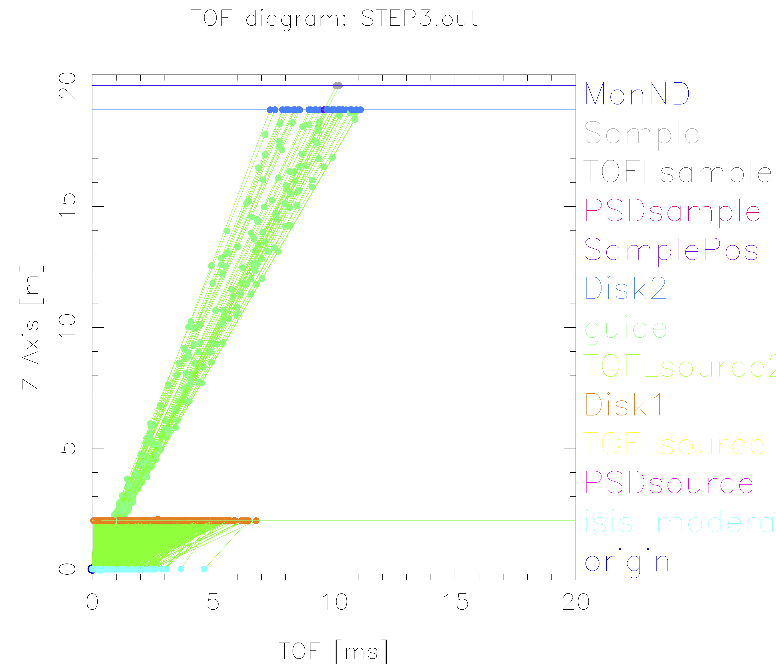
TOF diagram util based on mcdisplay
mcdisplay.pl --TOF --tmax=20 instrument…

Slide 24
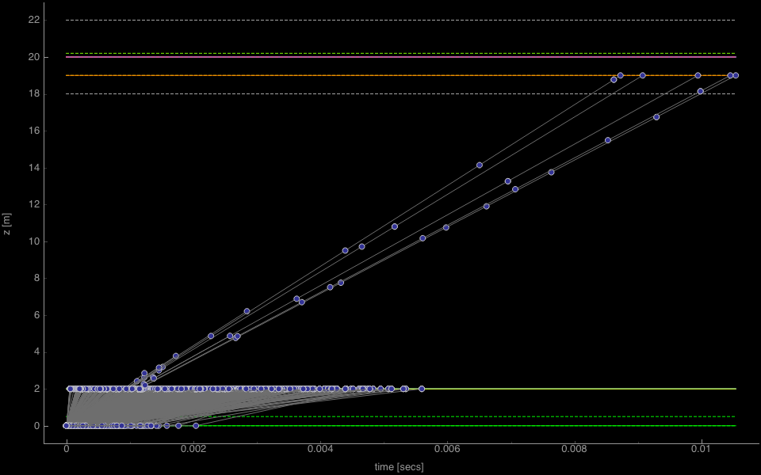
TOF diagram util based on mcdisplay
mcdisplay-pyqtgraph --TOF instr

Slide 25
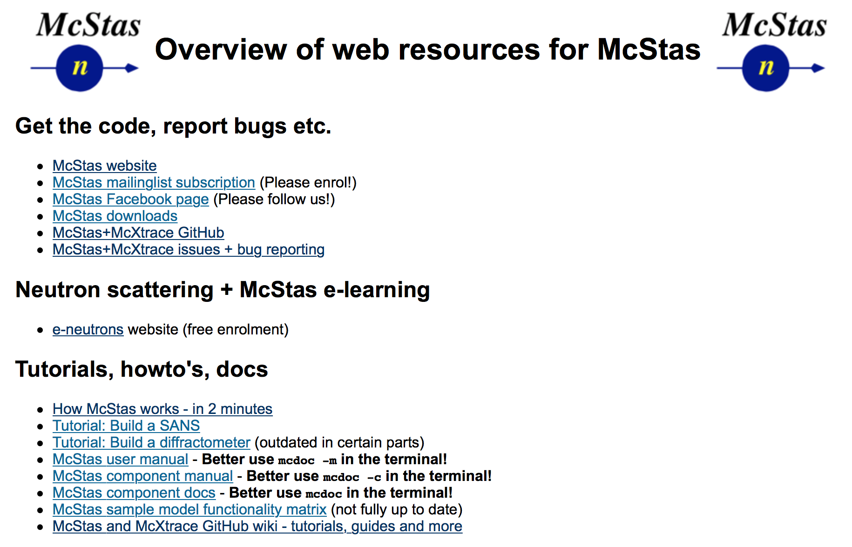
Useful links / docs
http://mcstas.org/links
https://github.com/McStasMcXtrace/McCode/wiki
Documentation on the McCode tools
User documentation for the 2017- Python tool set'
mcrun variants - table overview
mcplot variants - table overview
mcdisplay variants - table overview

Slide 26
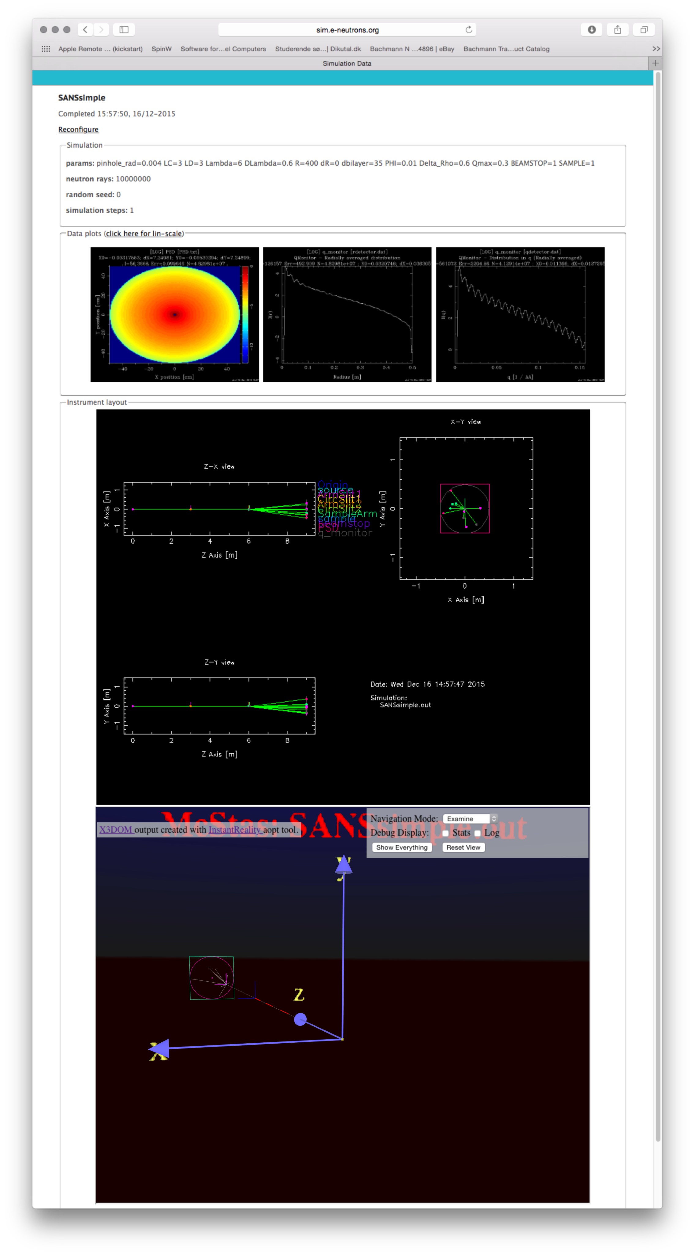
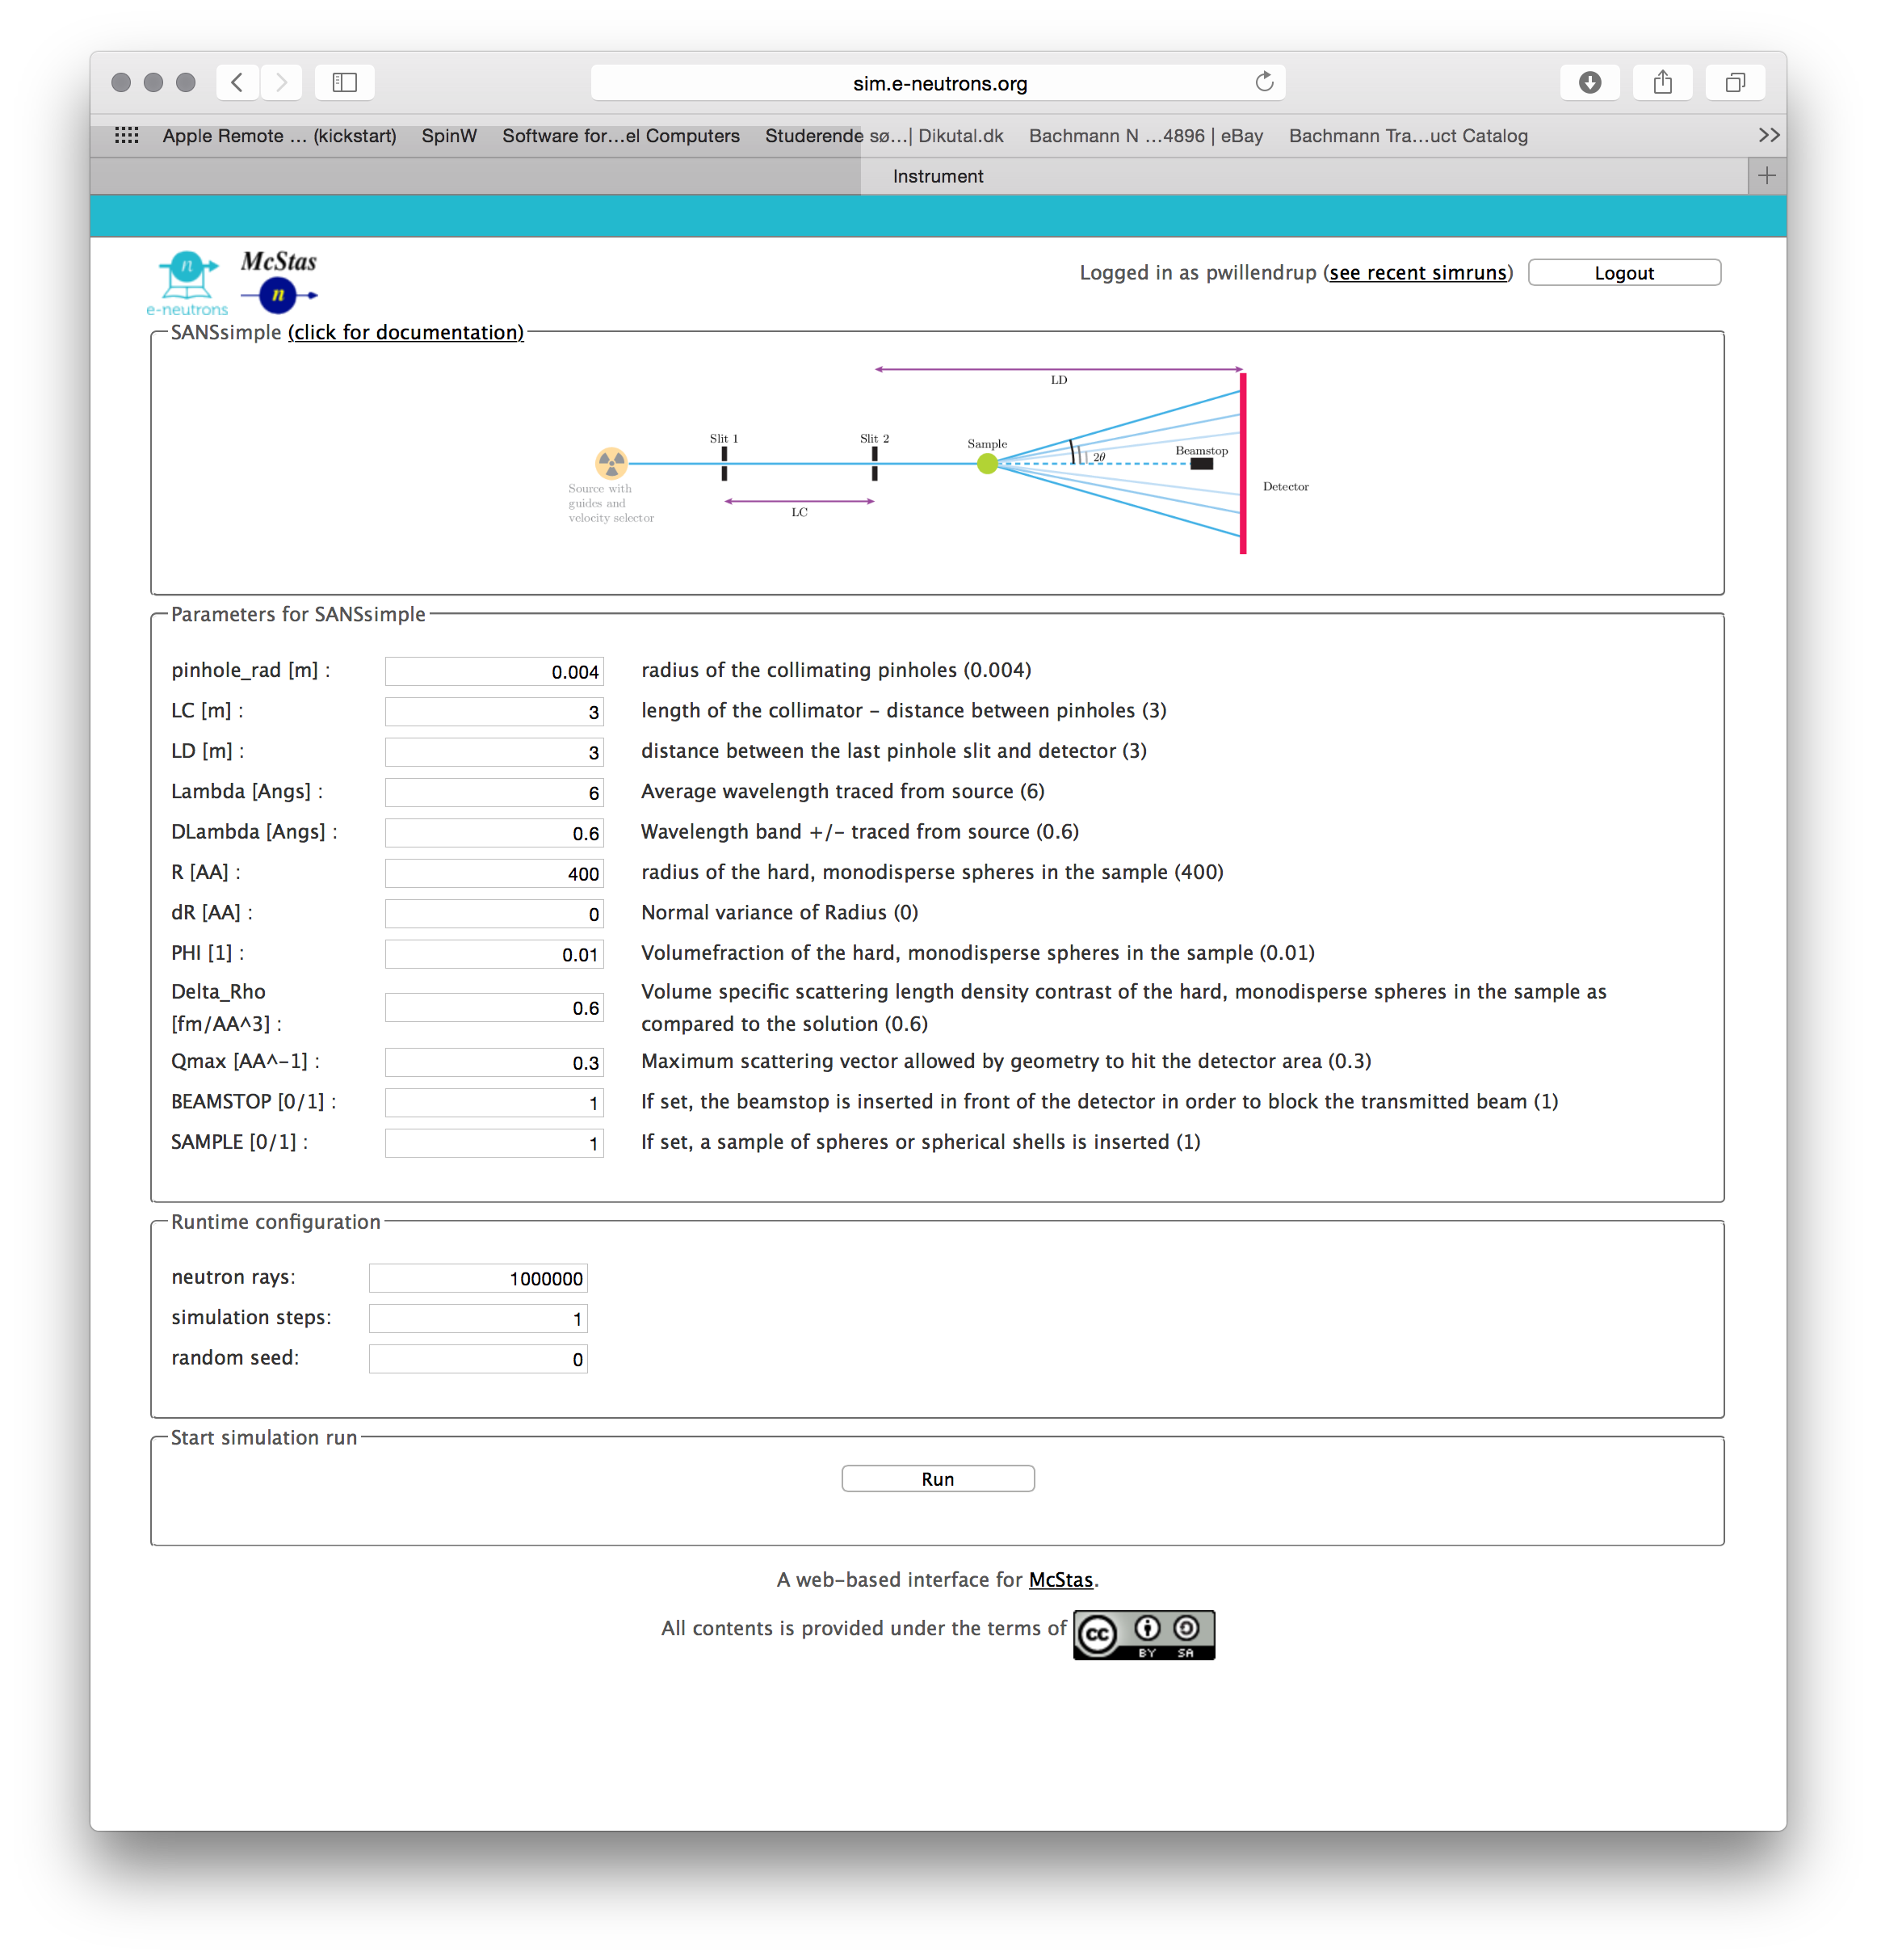
Web interface @ e-neutrons.org
October 2018
ORNL McStas workshop, October 18th-19th 2018

Slide 27
Web interface @ e-neutrons.org
October 2018
Only pre-defined instruments!!!
ORNL McStas workshop, October 18th-19th 2018

Slide 28
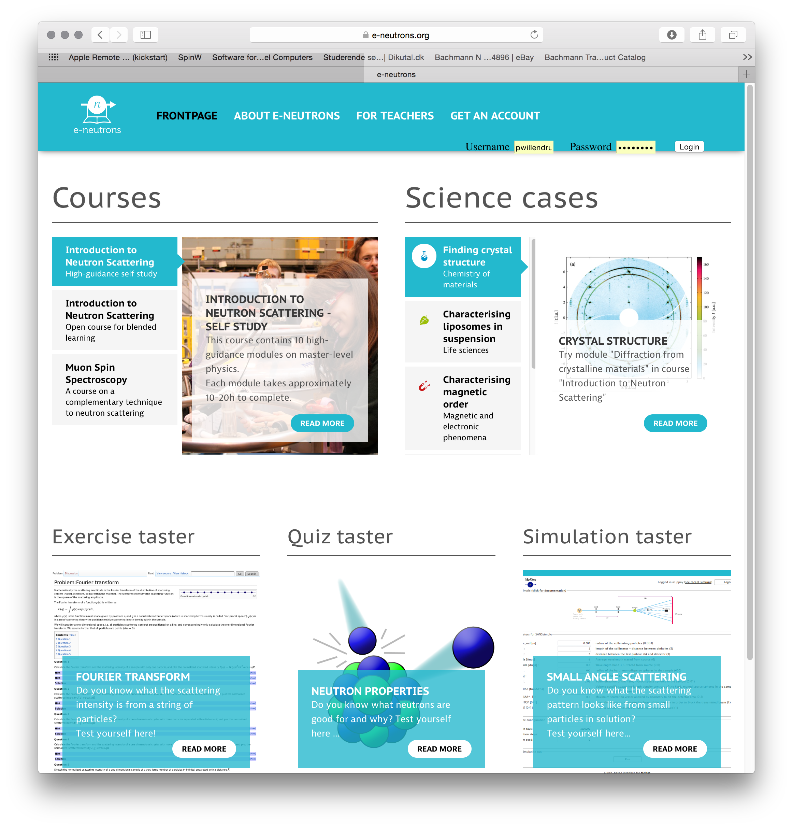
Web interface @ e-neutrons.org
October 2018
ORNL McStas workshop, October 18th-19th 2018

Slide 29
Web interface @ e-neutrons.org
October 2018
Online-course on neutron scattering available!
ORNL McStas workshop, October 18th-19th 2018

Slide 30
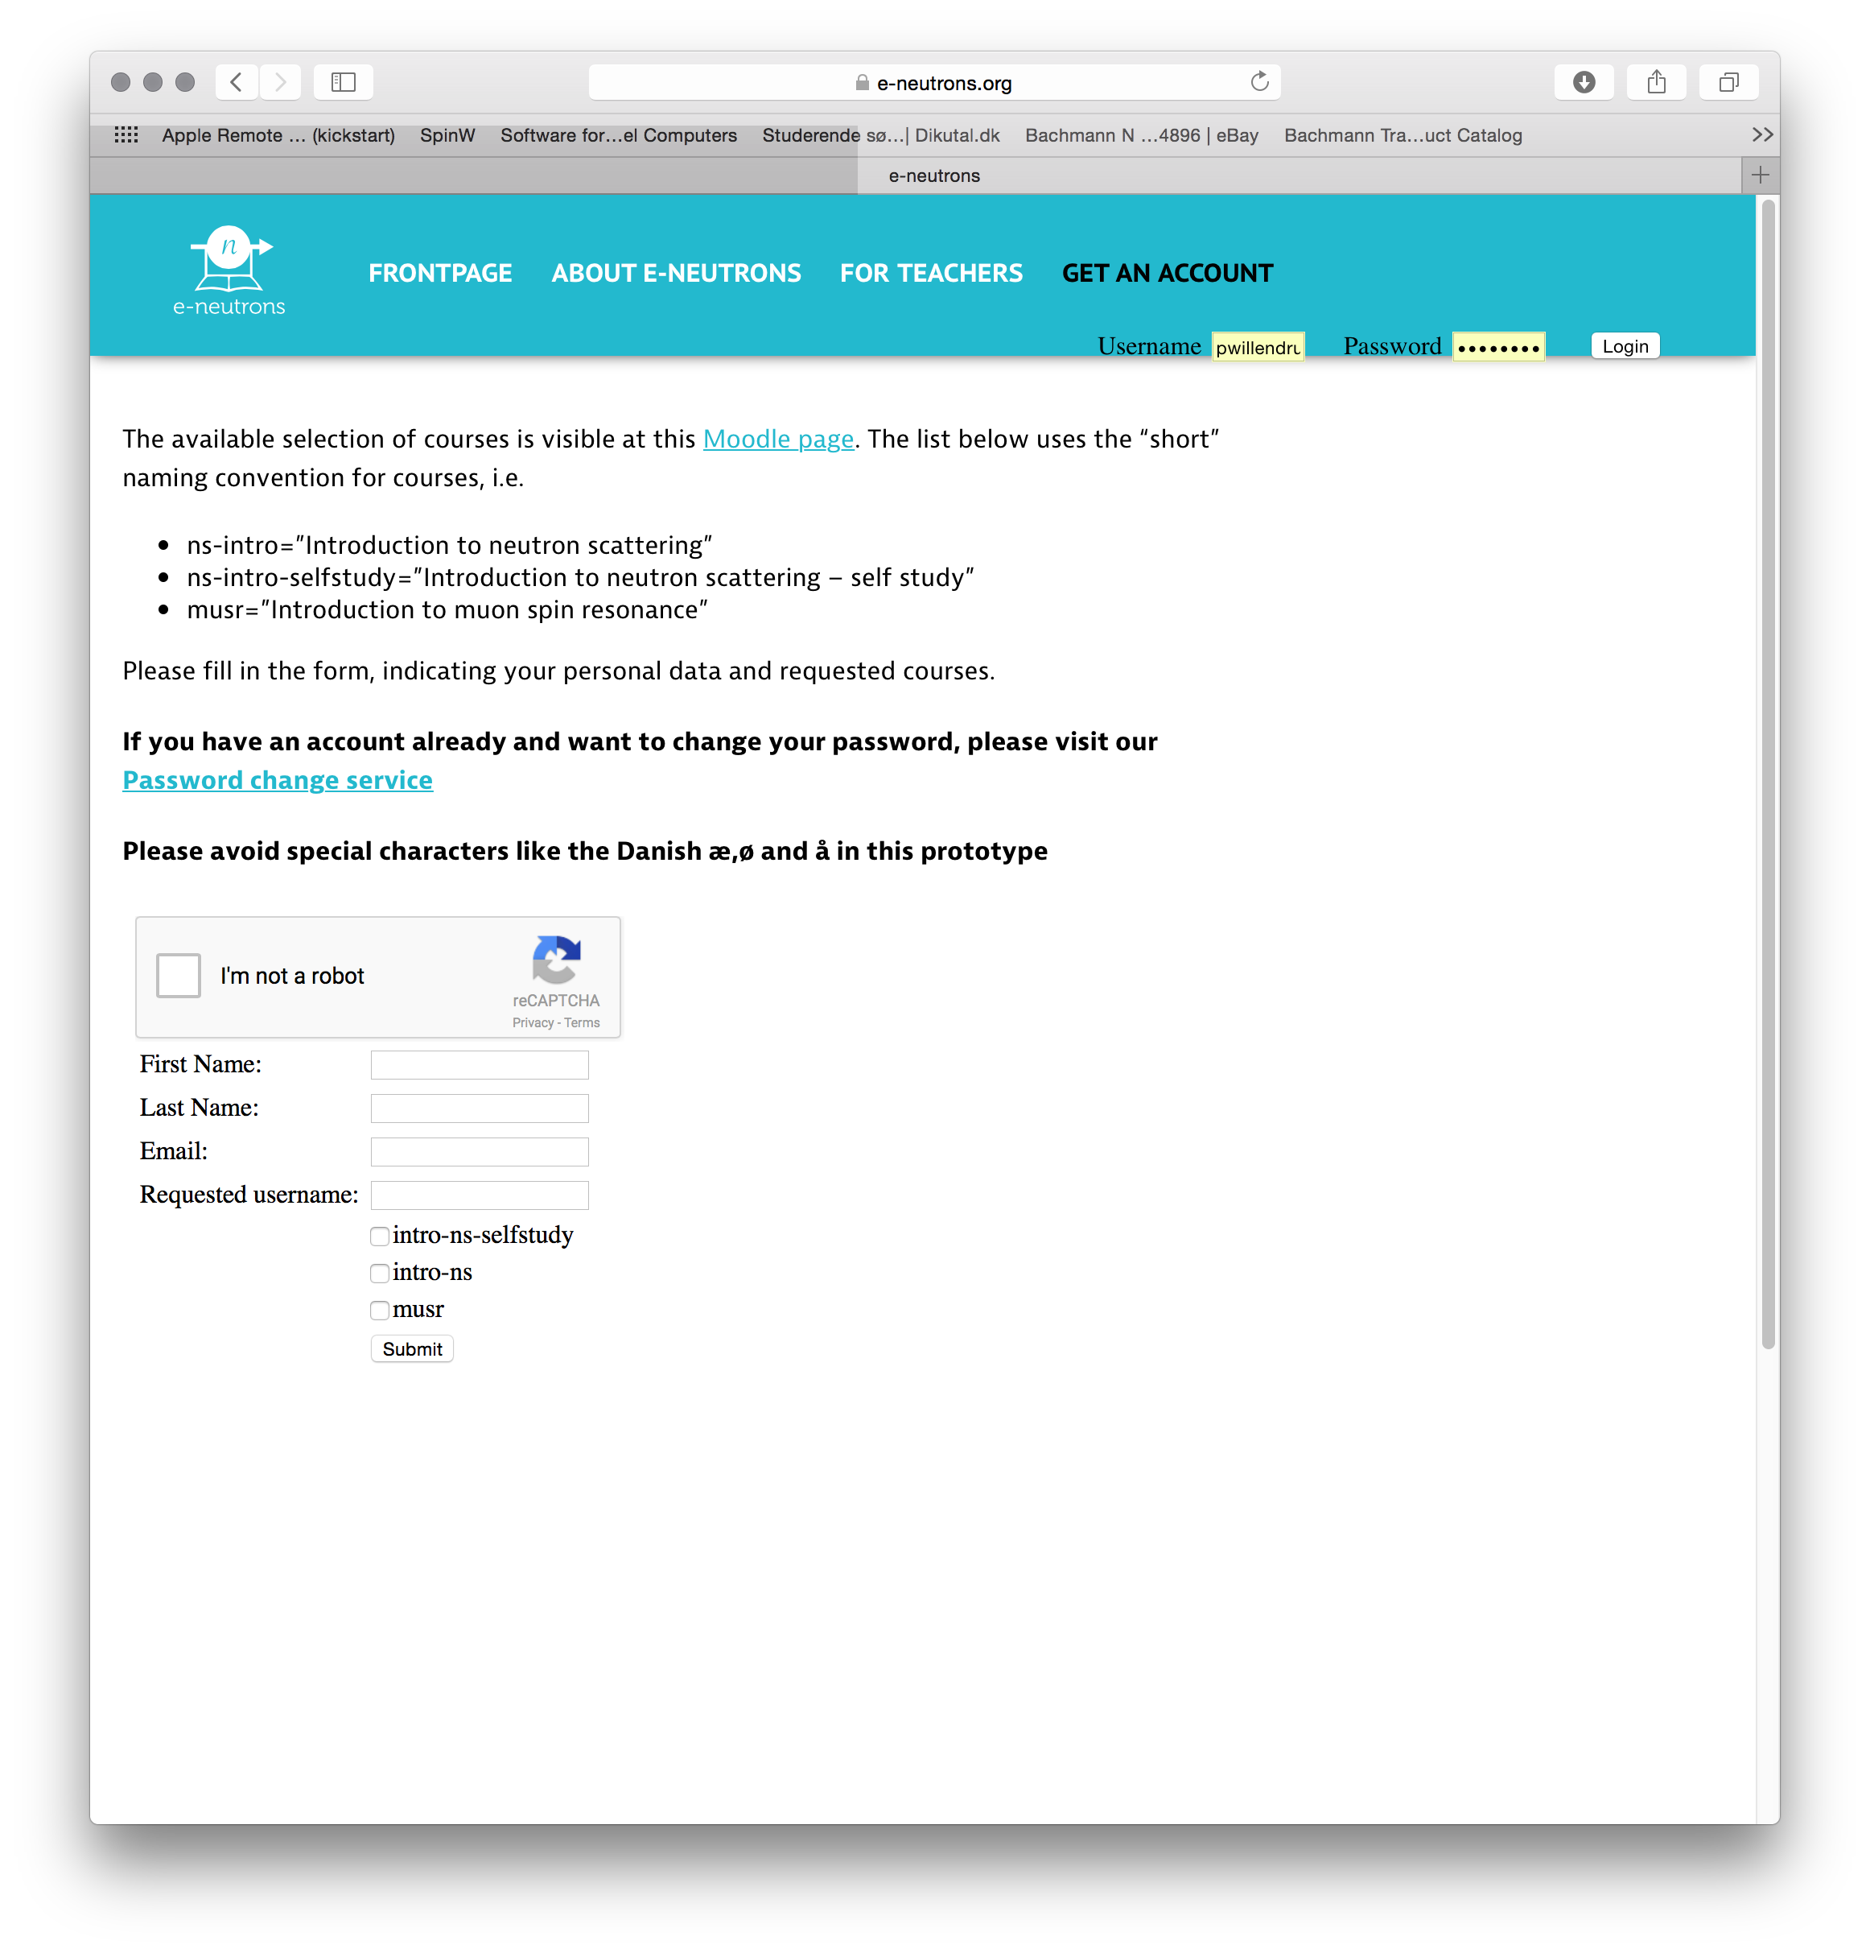
Web interface @ e-neutrons.org
October 2018
ORNL McStas workshop, October 18th-19th 2018

Slide 31
Web interface @ e-neutrons.org
October 2018
Free subscription!!
ORNL McStas workshop, October 18th-19th 2018

Slide 32
6 McStas various utils
Hidden gems and useful little things…
+ Disclaimers and tips for the next couple of days…

Slide 33
cif2hkl
Util for generating McStas style “laz/lau” reflection lists from CIF file
Based on CrysFML from the ILL (FullProf)
Compile for your system from https://github.com/McStasMcXtrace/McCode/tree/master/tools/other/cif2hkl
(May also get included in McStas 2.4)

Slide 34
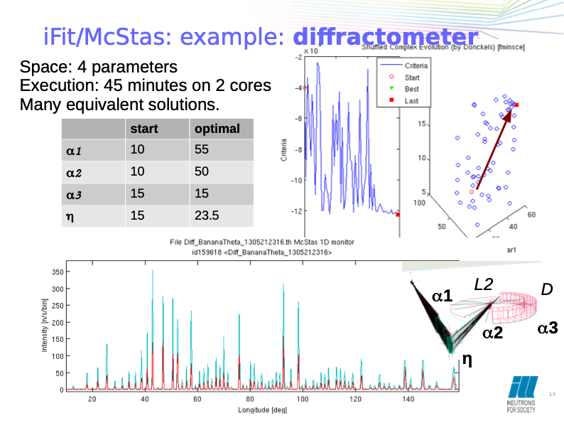
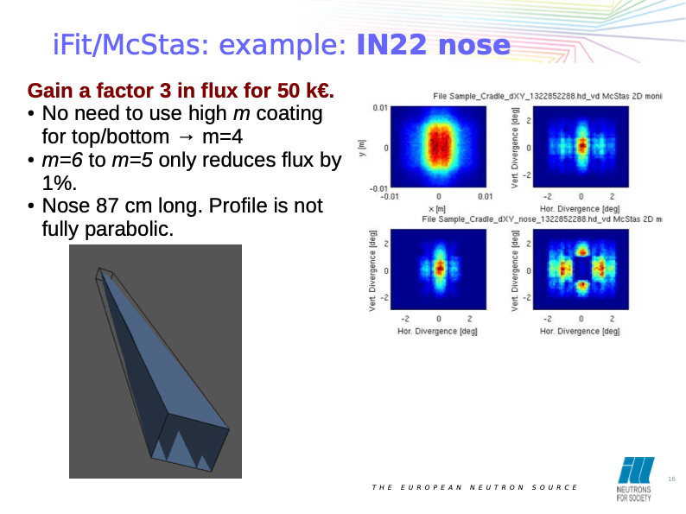
iFit optimiser (http://ifit.mccode.org)
General data / optimisation framework
~ Modern “spec_nd”
Matlab based, but does not require matlab (binary distribution also)
Reads and plots McStas
Can run McStas as a “cost function”, varying instrument parameters

Slide 35
Cluster utility scripts
mcsub cluster scripts
Takes a “mcrun commandline”
Writes batch file “template” for use with PBS or slurm cluster queue systems
https://github.com/McStasMcXtrace/McCode/tree/master/tools/cluster-scripts
./mcsub_slurm.pl
Usage: ./mcsub_slurm.pl [options] [mcrun params]
-h --help Show this help
-rN --runtime=N Specify maximum runtime (hours) [default 1]
-qQNAME --queue=QNAME Specify wanted SLURM queue [default 'express']
-e<mail> --email=<mail> Specify address to notify in reg. sim status [default none]
--nodes=NUM Specify wanted number of nodes [default 1]
--name=NAME Specify slurm job name [default "McSub_<USERNAME>_<TIMESTAMP>"]
After running ./mcsub_slurm.pl NAME.batch is ready for submission using the sbatch command

Slide 36
Vitess - compatibility
Utility script for converting Vitess reflectivity files for use with McStas (https://github.com/McStasMcXtrace/McCode/blob/master/tools/other/Refl_Vitess2McStas.sh)
mcstas2vitess generates Vitess module + tcl snippet from McStas component (poor docs, will improve)

Slide 37
Next: Time for exercises
Forming groups
Suggestion for Thursday-Friday exercises:
Often sitting with a colleague is helpful
Form teams of two people for the exercises
Try to gather complementary knowledge by teaming up with someone from a different work area

Slide 38
Next: Exercises
Disclaimers
We will likely find new and intersting bugs as we move along… :-)
Programme is flexible - don’t get frustrated if we lag behind, we will either adapt or catch up later!
Much of the teaching material is new / adapted, so there may be inconsistencies / confusion in some parts… :-)

